Slide 1
Draw Your Structure in a Creative Way
Xiao Sun

Slide 2
What Can 3D Effect Do?

Slide 3
From 1D to 3D

Slide 4
From 2D to 3D

Slide 5
Direct 3D Drawing

Slide 6
Example: Lenses

Slide 7
Example: Lenses

Slide 8
Example: Lenses

Slide 9
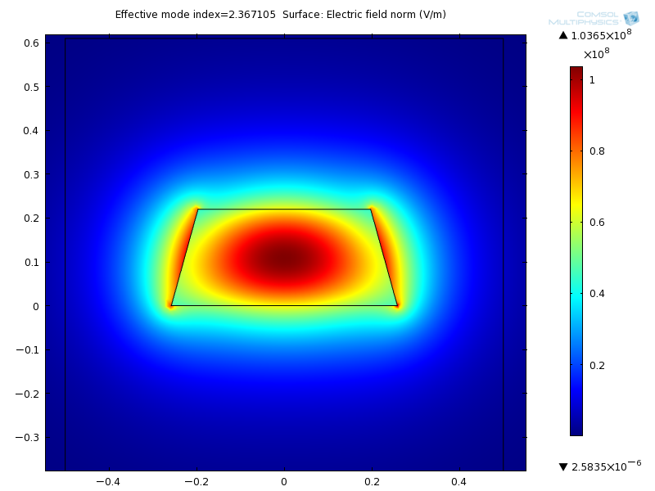
Example: Waveguides

Slide 10
Advanced Effect

